Slide 1
Describing the data
Dr Moses Ngari

Slide 2
Statistics
A science pertaining to the collection, analysis, interpretation & presentation of data.
How do we achieve this?
Describing the data, basic features and obtain simple summaries, freq
Making inferences about a pop from the data(sample)
Descriptive statistics
Inferential statistics

Slide 3
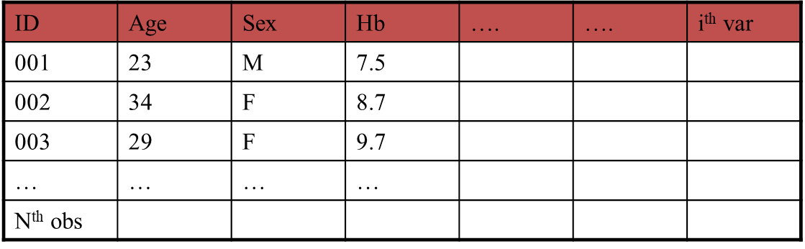
What is data
Data → Observations → Variables
Typically, observations are rows and variables are columns

Slide 4
Classes of variables Outcomes & Exposures
An Outcome is the variable of interest
E.g. death, illness, recovery of health, positive on laboratory test
An Exposure is a variable that we wish to investigate in relationship to an outcome
E.g. age, weight, infected with p. falciparum

Slide 5
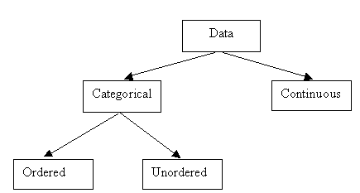
Variable types
Variables have a type
The type of a variable determines how we explore them

Slide 6
Categorical variables
Data that consist of only small number of values corresponding to a specific category value or label.
Ask yourself whether you can state out loud all the possible values of your variable without taking a breath. If you can, you have a pretty good indication that your data are categorical. In a study of breast feeding in pre-term infants, there are a variety of categorical variables:
Sex (male/female);
Working status(employed, not employed);
Education level (None, primary, secondary, tertiary)
Marital status (single, married, divorced, widowed)

Slide 7
Continuous variables
Data that consist of a large number of values, with no particular category label attached to any particular data value.
Ask yourself if your data can conceptually take on any value inside some interval. If it can, you have a good indication that your data are continuous. In the same study of breast feeding in pre-term infants, there are a variety of continuous variables:
the infant's birth weight in grams;
Age in years;
Math scores from 0 to 100
CD4 counts
Haemoglobin level in g/dl

Slide 8
Describing Data
Distributions
Tables and Graphs
Statistics
Mean, median
Range, quartiles, variance & standard deviation

Slide 9
Measures of Data: Completeness and validity
Prior to any kind of statistical analysis, one must
Determine completeness of data
Identify data elements that are questionable
Recode questionable data elements to “missing” or “unknown” values

Slide 10
Data types and measures
The way that we can summarize data depends on the type of the data
e.g. what is the range of a categorical variable?
Does order change this?
However, we can always show a frequency distribution

Slide 11
Measures of data
Distribution
Centrality
Variability

Slide 12
Distribution of data Continuous variable
Value | Frequency | Percent | Cumulative Percent
20 | 1 | 0.03 | 0.03
21 | 4 | 0.13 | 0.17
22 | 3 | 0.10 | 0.27
23 | 4 | 0.13 | 0.40
24 | 3 | 0.10 | 0.50
25 | 1 | 0.03 | 0.53
35 | 1 | 0.03 | 0.57
36 | 3 | 0.10 | 0.67
37 | 1 | 0.03 | 0.70
38 | 6 | 0.20 | 0.90
39 | 2 | 0.07 | 0.97
40 | 1 | 0.03 | 1.00

Slide 13
Distribution of data Categorical variable
Value | Frequency | Percent | Cumulative Percent
Male | 15 | 50 | 50
Female | 15 | 50 | 100

Slide 14
Statistical measures Centrality
There are three averages
Mean
What we all “know” as the average
i.e. sum of values/number of values
Median
The value that divides a distribution into two equal parts
Mode
Shoe sizes

Slide 15
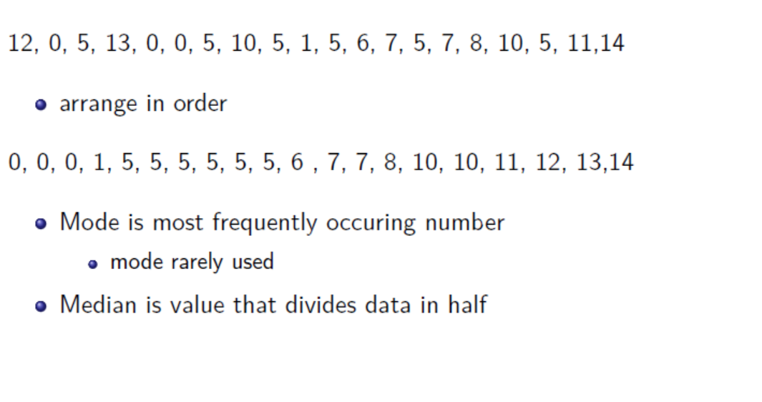
Measures of central tendency

Slide 16
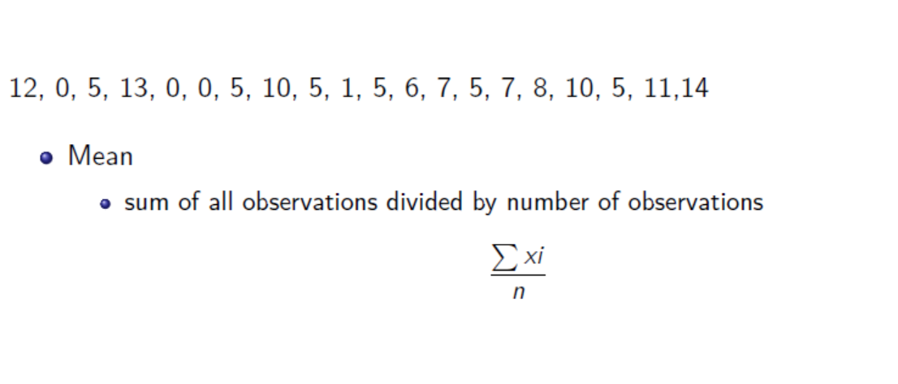
Measures of central tendency

Slide 17
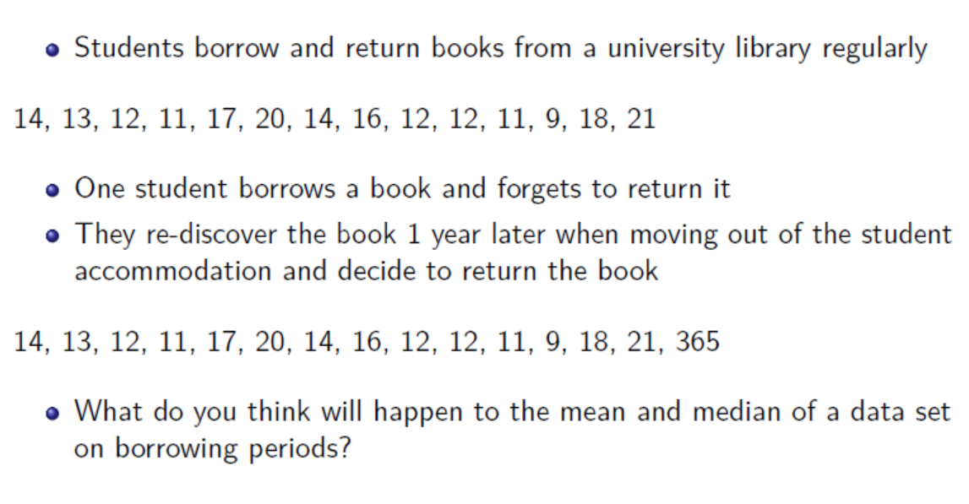
Library books illustrations

Slide 18
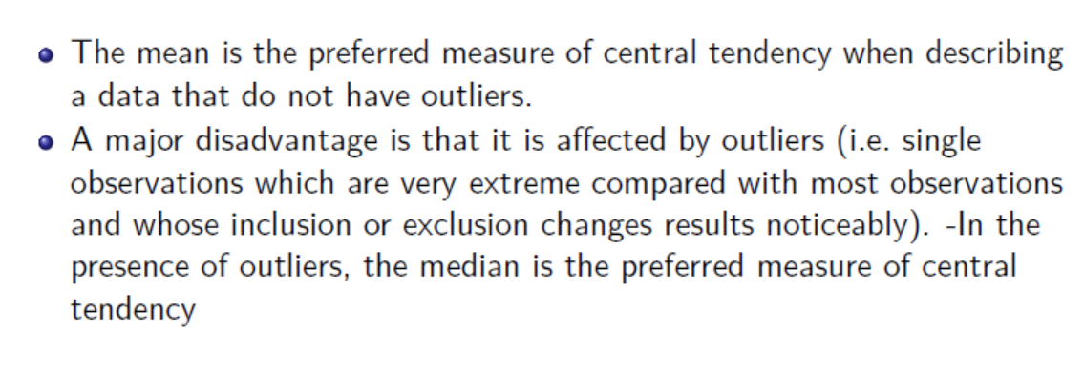
library books illustration

Slide 19
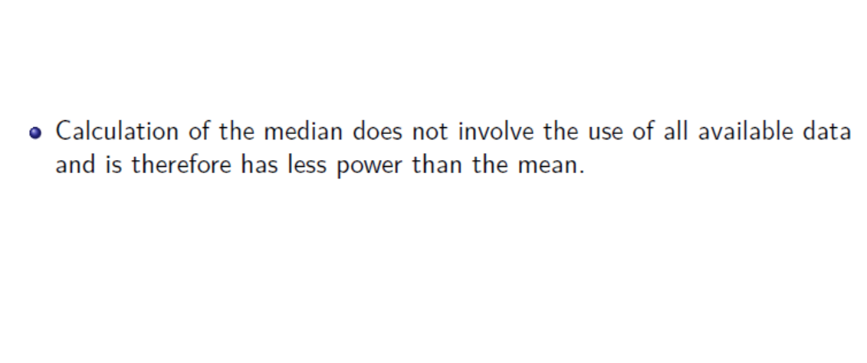
library books illustrations

Slide 20
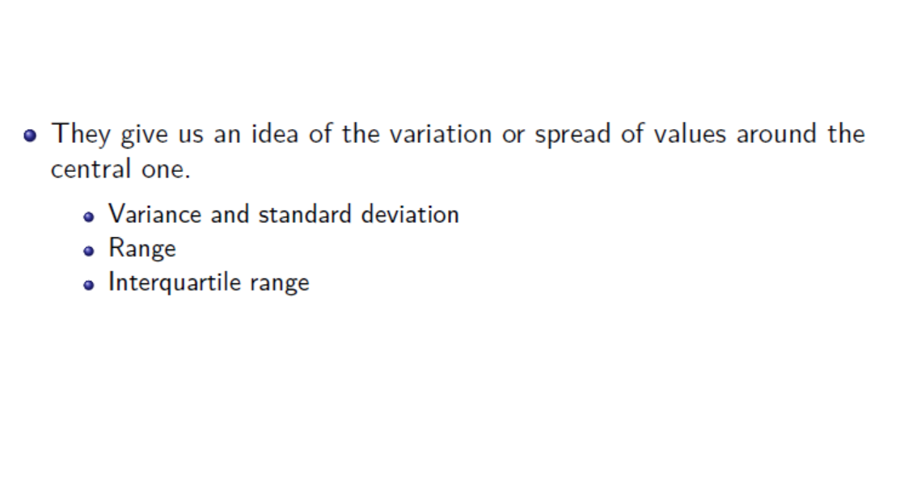
Measures of dispersion

Slide 21
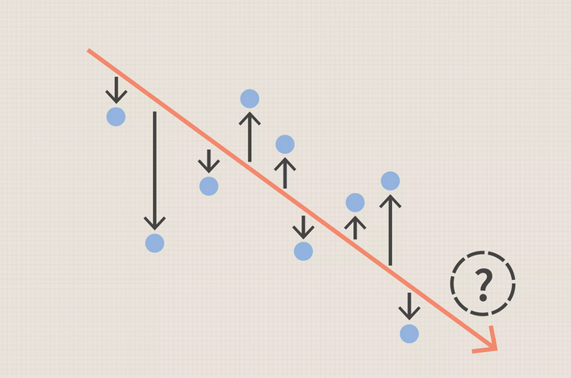
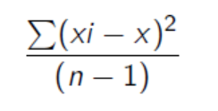
Variance

Slide 22
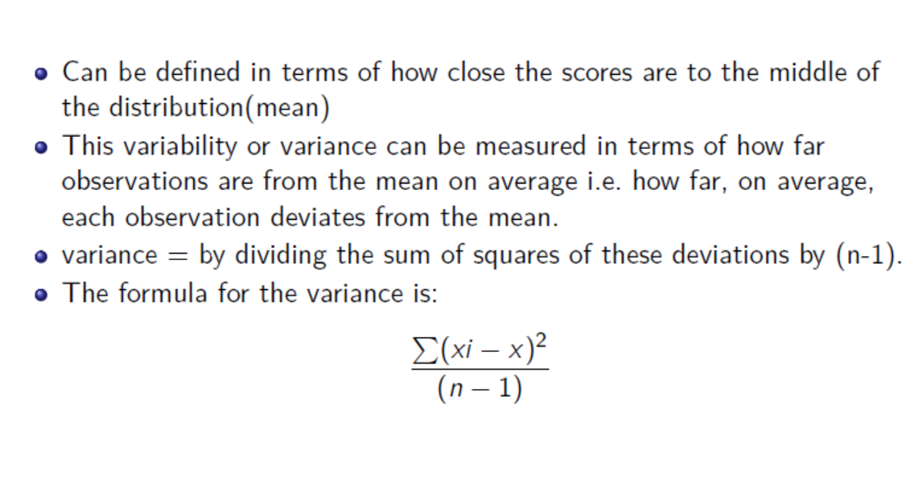
Variance

Slide 23
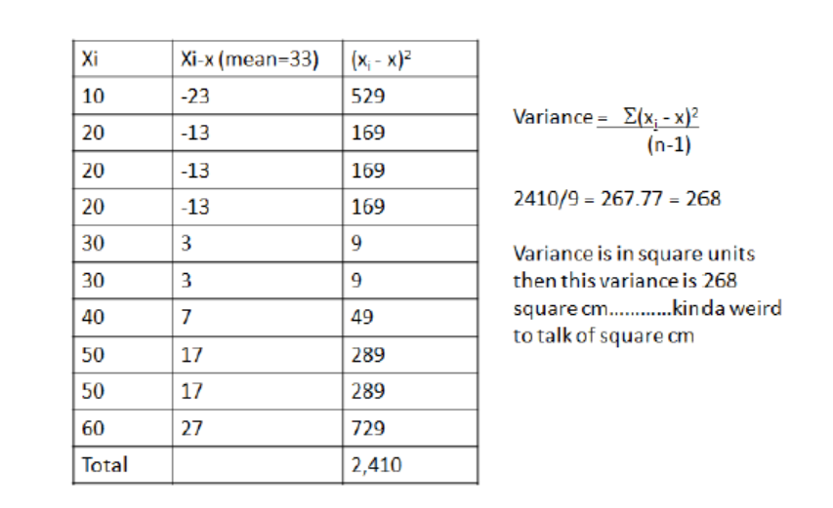
Variance

Slide 24
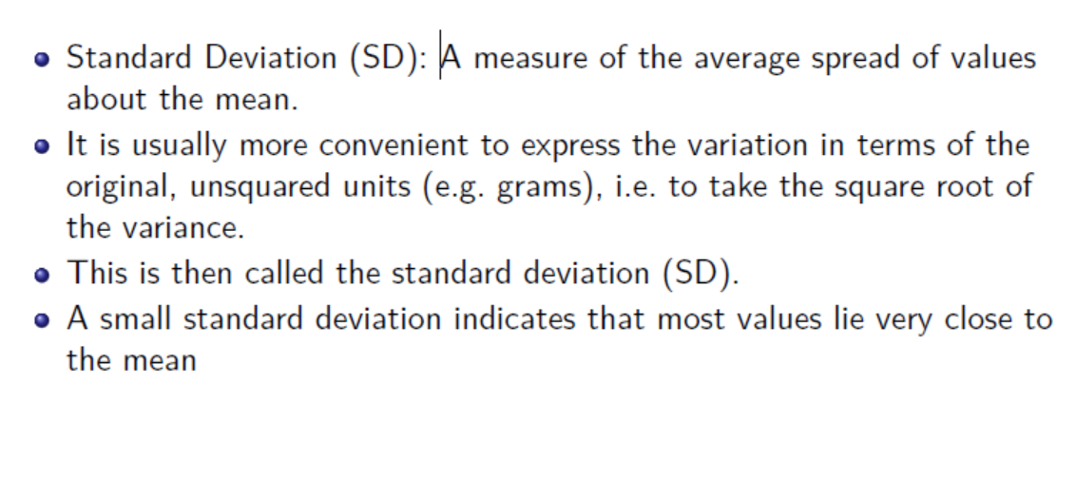
Standard deviation

Slide 25
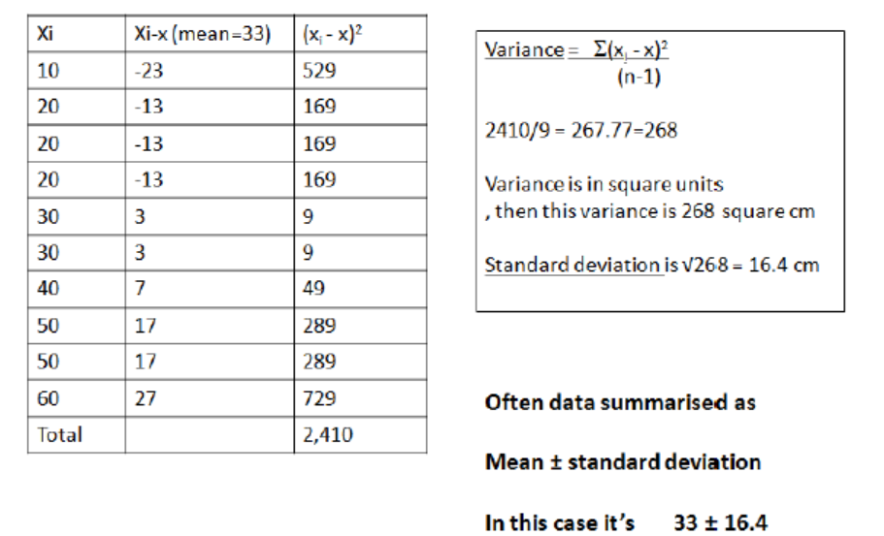
Variance to standard deviation

Slide 26
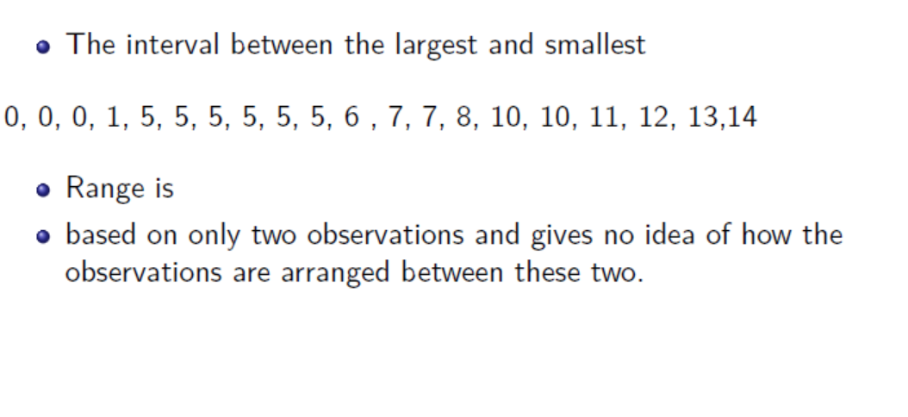
Measures of dispersion: Range

Slide 27
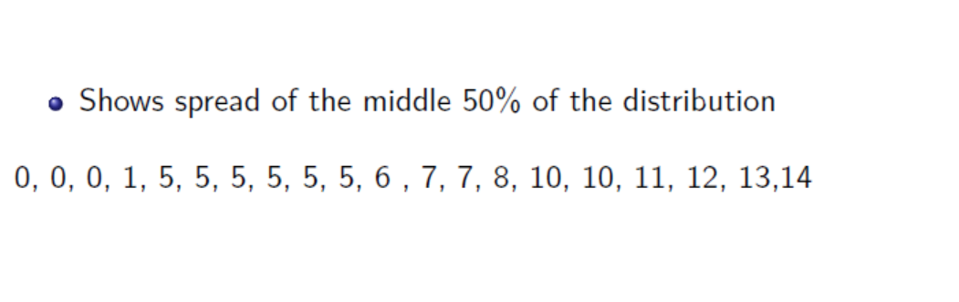
Measures of dispersion: Inter-Quartile Range

Slide 28
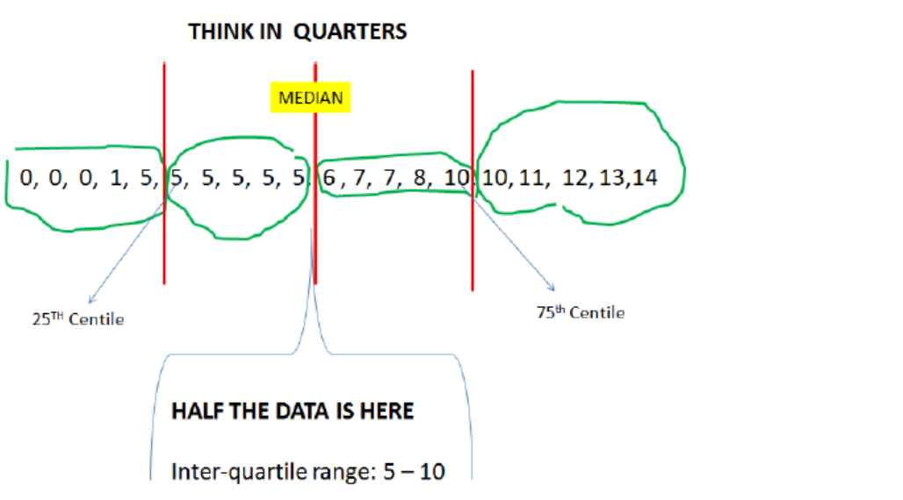

Slide 29
Graphical exploration of data
Bar graphs (for categorical data).
Histograms to show the shape of continuous data
Cumulative distribution frequency
Box and whisker graphs
For each graph we can compare our data with what we expect from the population
Frequency of values.
Distribution or shape.

Slide 30
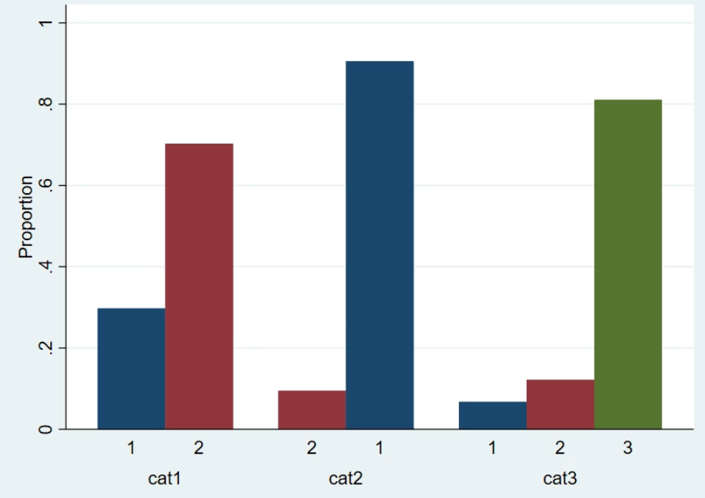
Bar charts for categorical data
Bar charts show the number or frequency in each category.

Slide 31
Histograms of continuous data
For continuous variables, a histogram is the best way to explore the assumption of normality.
Can show number of frequency (the shape is the same)

Slide 32
Histograms of continuous data
For counts, cytokine responses and other biological data, a log transformation may be needed

Slide 33
Cumulative distribution functions
A cumulative frequency graph can be shown. Need to generate a new variable with the cumulative distribution function (CDF)
Median at 50%

Slide 34
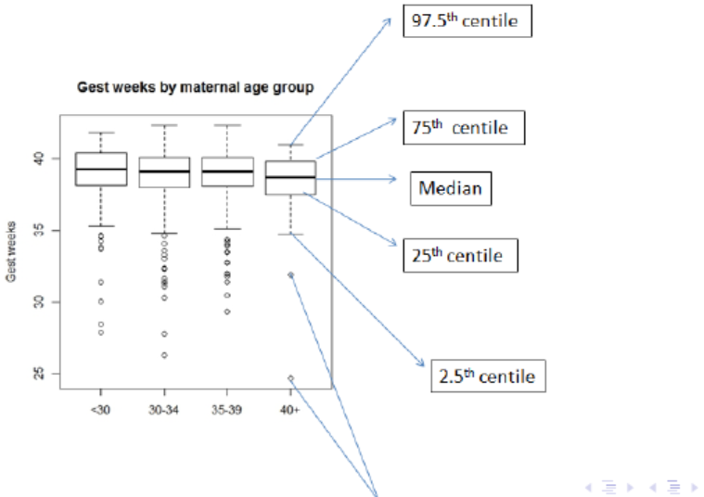
Box and whisker graphs
A box and whisker graph shows the median, interquartile range and extreme values.
It is suitable for skewed data, where it may not be correct to show mean and standard deviations.

